Slide 1





Final Review
REVIEW DATE: 4/12/2021
Smart Litter bin
Photo
(Author 1)
Photo
(Author 2)
Photo
(Author 3)
Roshan NV
N Aravind Kumar
Deepak S
Vellore Institute of Technology, Chennai Campus

Slide 2
Index
1
Objective
2
Concept /Scope of Solution
3
Existing System
4
Proposed System/Detailed Description
5
Methodology
6
Validation|Testing|Analysis
7
Cost and Benefits
8
Results
9
Conclusion
10
References

Slide 3
Objective
To Build a Litter Bin which is capable of being opened and closed by detecting the position of trash to be disposed and can also be moved at will using simple smartphone or a IR Transmitter
Concept / Scope of Solution
The idea is to build a upgraded version of the traditional dustbins found in average person’s house . This version of dustbin makes use of modern day electronics gadgets which includes sonar sensors, Receiver Transmitter Circuits etc.
Dustbin can be moved either using IR Remote or a Smartphone which consists of an IR Sensor inside it.
Smart Litter Bin doesn’t consume much DC voltage supply and has a very good life span which makes it a very viable solution to implement in major Littered areas

Slide 4
Existing System
At Present, Most of the Dust Bins present in Chennai are not automated and they require to be manually opened and closed.
This is not consistent with COVID 19 Measures as they require contact with the Bins and can potentially spread of the virus.
So a Contact-less Dust Bin is the need of the hour
Proposed System
In the proposed System, Dust Bin is automated by the use of Ultrasonic sensors which facilitates the automatic opening and closing of lids and we aim to monitor various parameters of the Dust bin
We plan to include a IR module to receive and transmit signals between two devices to move the Dust bin in any angle possible in a short distance range
Both opening and closing of the lid of the Dust bin and moving the Dust bin between two different points is facilitated by using two seperate microcontrollers each serving the purpose individually

Slide 5
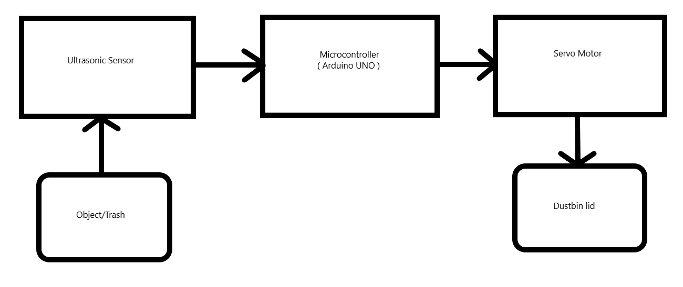
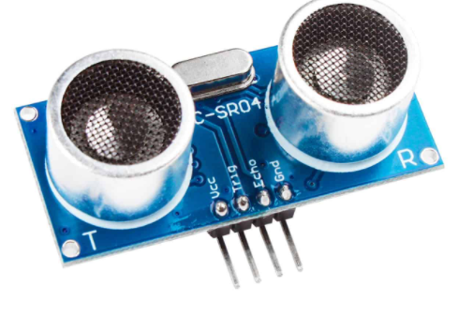
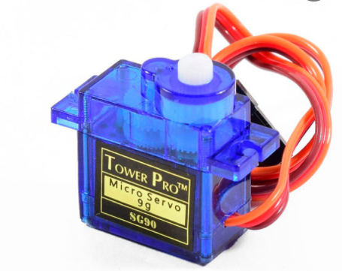
Methodology
Part - 1 : Building a Contactless Dust bin
Firstly, We would be needing a microcontroller which would act the as the brain of the system. We are using Arduino UNO Microcontroller for the purpose
Nextly, We would be incorporating the concept of contactless Dust Bin by using ultrasonic sensor and a Servo Motor with DC Power supply
As soon as the object is in the range of detection of Ultrasonic sensor , a signal is sent to the microcontroller where a decision made according to the programming logic to rotate the servo motor by angle of 150 degrees.
If the object is out of range of detection of Ultrasonic sensor or no object is placed, Then accordingly the servo motor is taken back to it’s initial position and the lid of the Dust bin is closed
Ultrasonic Sensor
Servo Motor

Slide 6
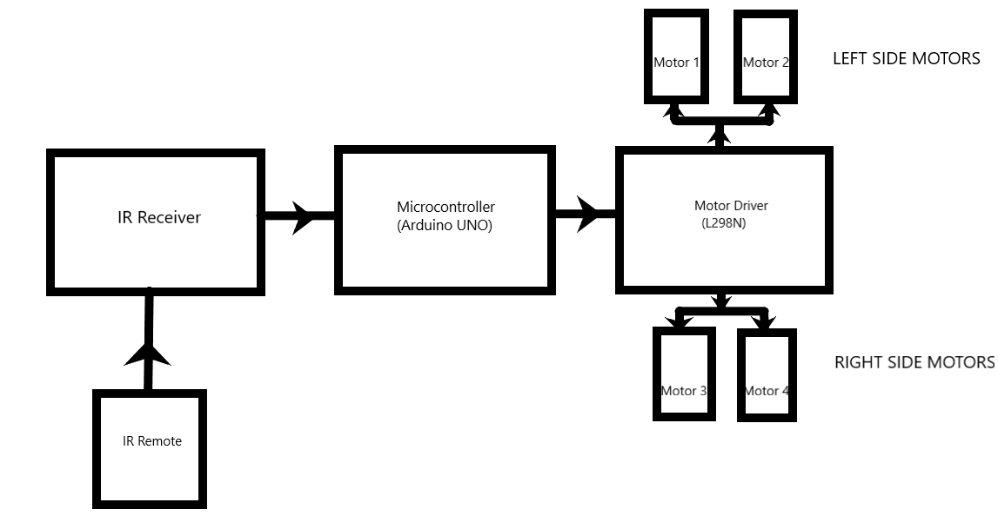
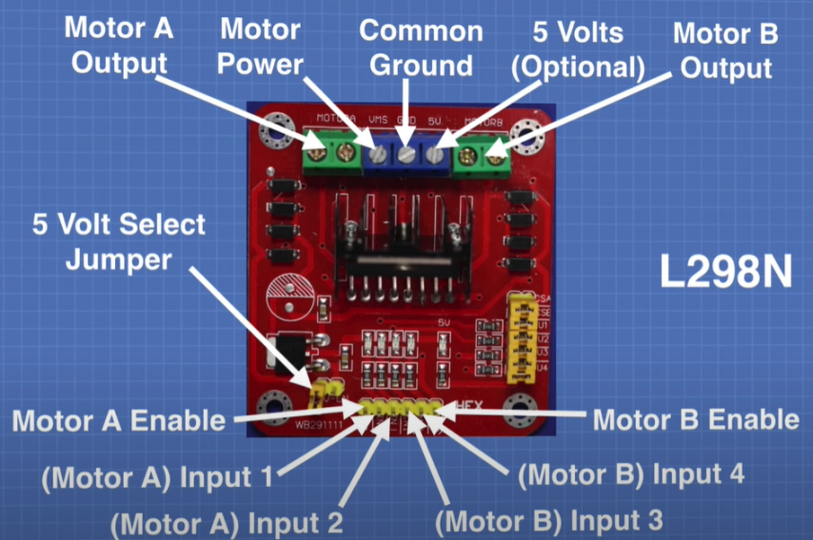
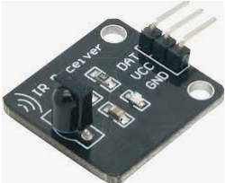
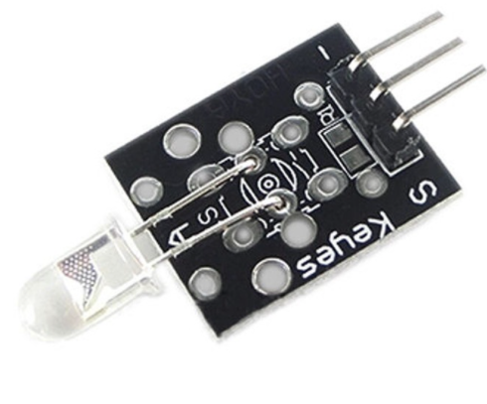



Part - 2 : Building a RC controlled Dust Bin
In order to configure the buttons of the IR Transmitter to the direction of movement of car, We need to do it internally using Hex Code generated by each buttons of the IR Transmitter.
After receiving the IR Signals from the Remote,The Demodulated Signals are sent to the microcontroller and it decodes it to identify the button being pressed.This data is then fed into the microcontroller where decision is made in accordance to the programming logic written by the user involving the direction and orientation of movement of car.
The signal is then sent into the Motor Driver(L298N) where each side of the car are controlled seperately. The two motors of one side are connected commonly to input 1 and 2 of Motor A and other 2 motors of one side are connected commonly to input 1 and input 2 of Motor B.The input to the Motor driver is sent by the microcontroller which in turn depends on the Buttons pressed on the IR Transmitter. Thus controlling the orientation of the car.

Slide 7
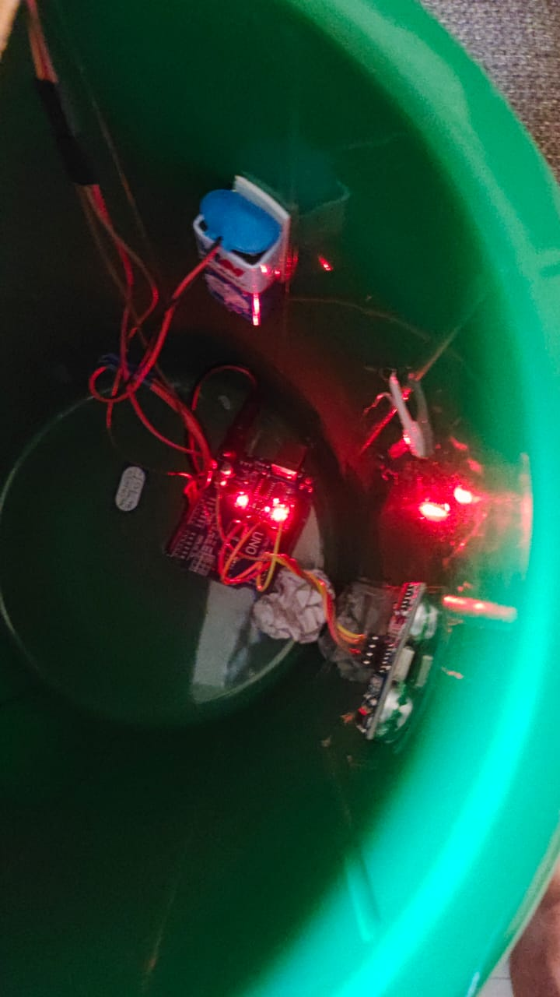
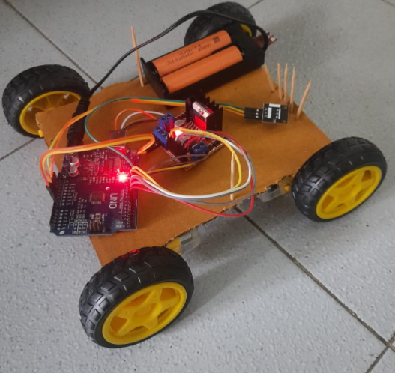
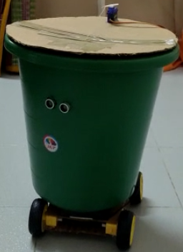
Validation/Analysis

Slide 8
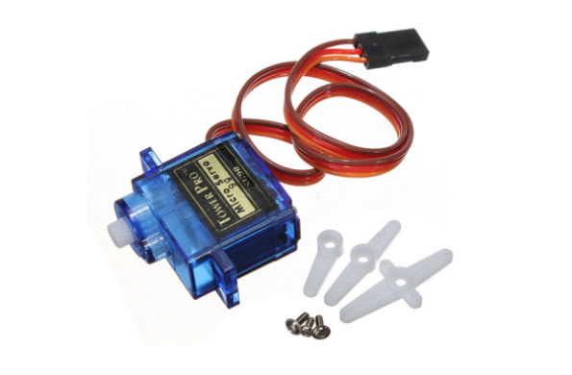
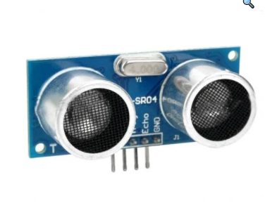
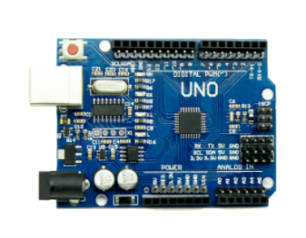
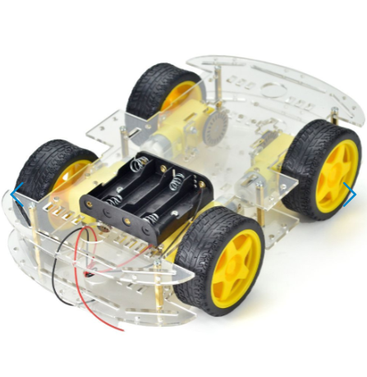
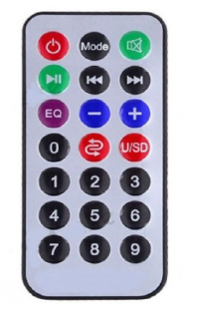
Costs :
Dustbin:
Arduino uno – Rs 542
Ultrasonic sensor – Rs 214
Servo motor – Rs 199
Total cost for dustbin part = Rs 995
RC Controlled Car:
Arduino uno – Rs 542 = Rs 542
L298 Motor driver module – Rs 289
IR Receiver Module DIY Kit HX1838 - Rs 350
Chasis (TT Gear motor(4x) + Rubber wheels(4x)) – Rs 450
18650 Li ion battery (2x) – Rs 297 x 2 = Rs 594
Total cost for RC part = Rs 2225
Final cost = Rs 3220

Slide 9
Benefits :
This Project hugely has immense benefits in the current pandemic situation as this elimnates the concept of physical contact altogether
The smart dustbin doesn’t require immense DC power supply which makes it a very good successor to the traditional dustbins
They can later be modified to have even more features as microcontrollers purely work on the programming logic developed by the user
Results :
We have completed the first half of our project which is to construct a contactless dustbin using the ultrasonic sensors and a servo motor and we have incorporated the RC Controlled Car using IR Transmittion and Communication
Conclusion :
So at the end of our project we have successfully completed in modernizing the traditional dustbins by incorporating the idea of opening and closing a dustbin without any physical contact and to control the position of a dustbin using just a Smartphone or a IR Receiver.

Slide 10
References
Rohit, G. S., Chandra, M. B., Saha, S., & Das, D. (2018, April). Smart dual dustbin model for waste management in smart cities. In 2018 3rd International Conference for Convergence in Technology (I2CT) (pp. 1-5). IEEE.
Pardini, K., Rodrigues, J. J., Hassan, S. A., Kumar, N., & Furtado, V. (2018, August). Smart waste bin: a new approach for waste management in large urban centers. In 2018 IEEE 88th Vehicular Technology Conference (VTC-Fall) (pp. 1-8). IEEE.
Zimmerman, T. G., Lanier, J., Blanchard, C., Bryson, S., & Harvill, Y. A hand gesture interface device. ACM Sigchi Bulletin, 18(4), 189-192.
Gaddam, A., & Nikhath, A. K. (2021). Smart Dustbin: A Reward Provider. In Proceedings of International Conference on Advances in Computer Engineering and Communication Systems (pp. 1-11). Springer, Singapore.
Dugdhe, S., Shelar, P., Jire, S., & Apte, A. (2016, January). Efficient waste collection system. In 2016 International Conference on Internet of Things and Applications (IOTA) (pp. 143-147). IEEE.
Dhyani, K., & Patel, N. (2018, July). Smart trash monitoring and segregation system using emerging technology—a survey. In International Conference on Advanced Informatics for Computing Research (pp. 667-674). Springer, Singapore.
Kumar, N. S., Vuayalakshmi, B., Prarthana, R. J., & Shankar, A. (2016, November). IOT based smart garbage alert system using Arduino UNO. In 2016 IEEE region 10 conference (TENCON) (pp. 1028-1034). IEEE.

Slide 11
https://techatronic.com/smart-dustbin-with-arduino-step-by-step-guide/\
https://create.arduino.cc/projecthub/shubhamsuresh/how-to-make-a-gesture-control-robot-at-home-a3f4a4
https://www.electronicshub.org/hand-gesture-controlled-robot/
https://www.rcciit.org/students_projects/projects/aeie/2019/GR4.pdf
https://create.arduino.cc/projecthub/mohd-shahid/smart-dustbin-using-arduino-c0bb7a
https://www.researchgate.net/publication/343530056_SMART_DUSTBIN_USING_ARDUINO
https://www.electroniclinic.com/smart-dustbin-using-arduino-ultrasonic-sensor-and-servo-motor/
https://nevonprojects.com/smart-dustbin-with-iot-notifications/
https://www.rcciit.org/students_projects/projects/aeie/2019/GR4.pdf
https://www.researchgate.net/publication/342151004_Hand_Gesture_and_Voice_Controlled_Smart_Vehicle
https://maker.pro/arduino/projects/hand-gestures-robot
https://techatronic.com/how-to-make-gesture-control-robot-using-arduino/
https://innovate.mygov.in/innovation/smart-dustbin/#:~:text=The%20smart%20dustbin%20is%20a,an%20incentive%20of%20throwing%20garbage
https://www.electronicshub.org/smart-dustbin-using-arduino/
https://circuitdigest.com/microcontroller-projects/accelerometer-based-hand-gesture-controlled-robot-using-arduino
https://people-ece.vse.gmu.edu/~jkaps/courses/ece511-f17/project/Group-8-Proposal.pdf

